Slide 1

Macroeconomic Objectives
Unemployment
3.3
Copyright Bananaomics

Slide 2

What are the 3 main objectives of an economy?
Copyright Bananaomics

Slide 3

3 Macro Objectives
  Economic Growth
  Low Unemployment Rate
  Low and Stable Inflation
Possible additional goals: Sustainable Debt, Equity, and Income Distribution
Copyright Chandler Bell

Slide 4


Definition
Unemployment
People who are willing, able, and actively seeking employment, but unable to find it.
Copyright Bananaomics

Slide 5

Definition
Labour Force / Work Force
People of working age (18-65) who are employed or unemployed SEEKING work.
To be considered in the labour force, 3 criteria must be met:
  Willing to work
  Able to work
  Seeking employment
Copyright Bananaomics

Slide 6

Definition
Discouraged Workers
People who are of working age but have been unemployed and not currently looking for a job. They are not included in the workforce.
Copyright Bananaomics

Slide 7

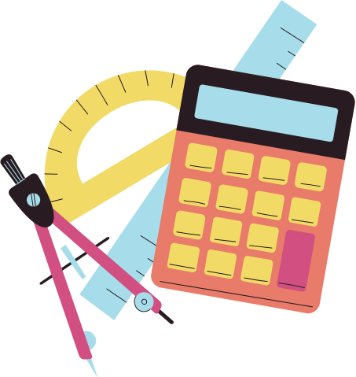

Unemployment Rate
Unemployment Rate
The number of unemployed workers expressed as a percentage of the total workforce / labour force.
Number of Unemployed
Unemployment Rate
100
Total Labour Force
Copyright Bananaomics

Slide 8

Unemployment Rate
Data
1.
Total Number of Labour Force: 12,347 (thousands)
Number of Employed People: 11,780 (thousands)
2.
Number of Employed People: 37,000 (thousands)
Working Age Population: 43,000 (thousands)
Discouraged Workers: 2,800 (thousands)
Copyright Bananaomics

Slide 9
Unemployment Rate
Data
Find the number of unemployed: 12,347 -11,780 = 567 thousand unemployed
567
100
4.59%
12,347
Labour Force = 43,000 - 2,800 = 40,200
Number of unemployed: 40,200 - 37,000 = 3,200
3,200
100
7.96%
40,200
Copyright Bananaomics

Slide 10
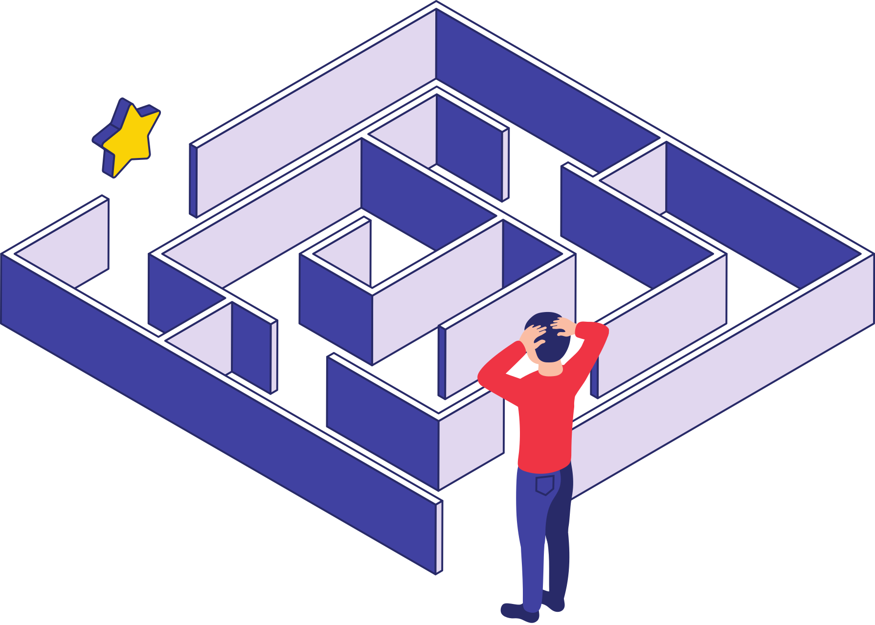
Difficulties in Measuring Unemployment
Hidden Unemployment
Workers that have part-time jobs but highly-skilled qualifications are not fully utilizing their efficiency. *Also known as underdemployed*
Discouraged Workers
Workers that have stopped looking for employment.
Issues with race, age, and gender information
Race, age, and gender gaps in unemployment are not typically calculated.
Informal Jobs
People employed as unregistered workers or illegal jobs.
Copyright Bananaomics

Slide 11
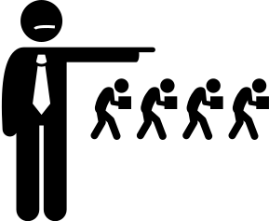
Causes of Unemployment
Copyright Bananaomics

Slide 12
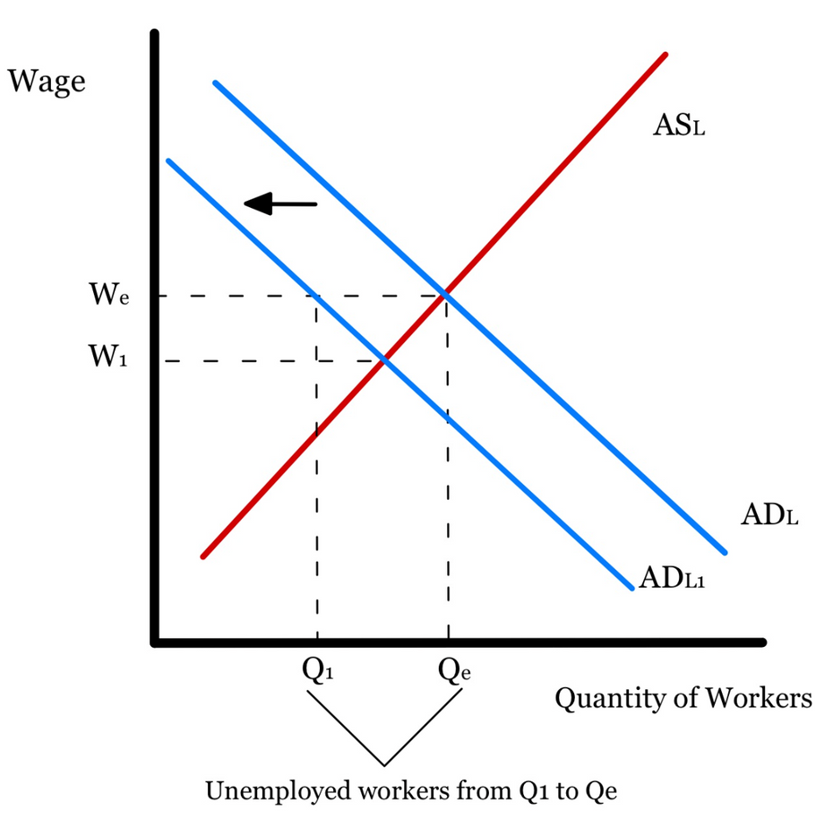
Types of Unemployment
Cyclical (Demand-Deficient)
Unemployment occurs due to a recession or a reduction in aggregate demand.
Think: Cyclical = Downturn in the Business Cycle
Graph Note
When drawing cyclical unemployment, use ASL and ADL as cyclical employment affects all sectors in the economy.
Copyright Bananaomics

Slide 13
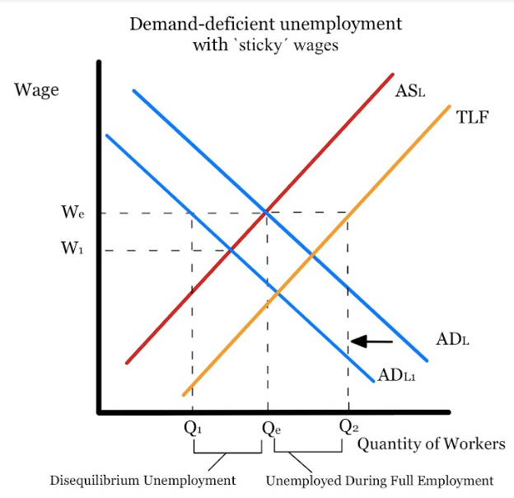
Demand Deficient Unemployment Showing Natural Rate of Unemployment
Graph Note
Due to sticky wages, when calculating the amount of unemployed and the Natural Rate of Unemployment, the wage levels will stay the same.
Copyright Bananaomics

Slide 14



Types of Unemployment
Frictional
People who are between jobs or recently removed from school.
Think: Frictional = looking for a good Fit
Copyright Bananaomics

Slide 15

Types of Unemployment
Seasonal
Occurs when specific jobs are only offered periodically during certain times in the year.
Think: Seasonal = Santa
Copyright Bananaomics

Slide 16



Types of Unemployment
Structural
Occurs when there is a change in demand for particular skills in the labor market such as technological changes, geographical changes, or changes in patterns of demand for particular skills.
Think: Structural = Lack of the correct Skills
Copyright Bananaomics

Slide 17
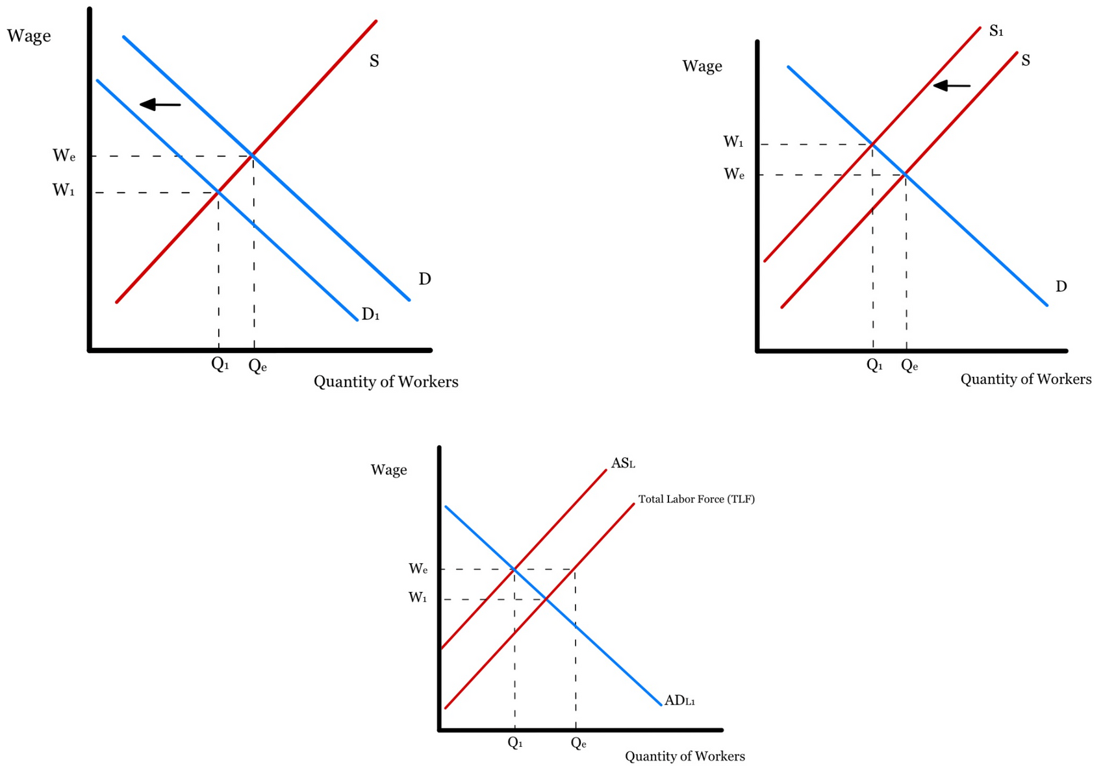
Any decrease of S or D results in inefficiency in the economy.
Copyright Bananaomics

Slide 18
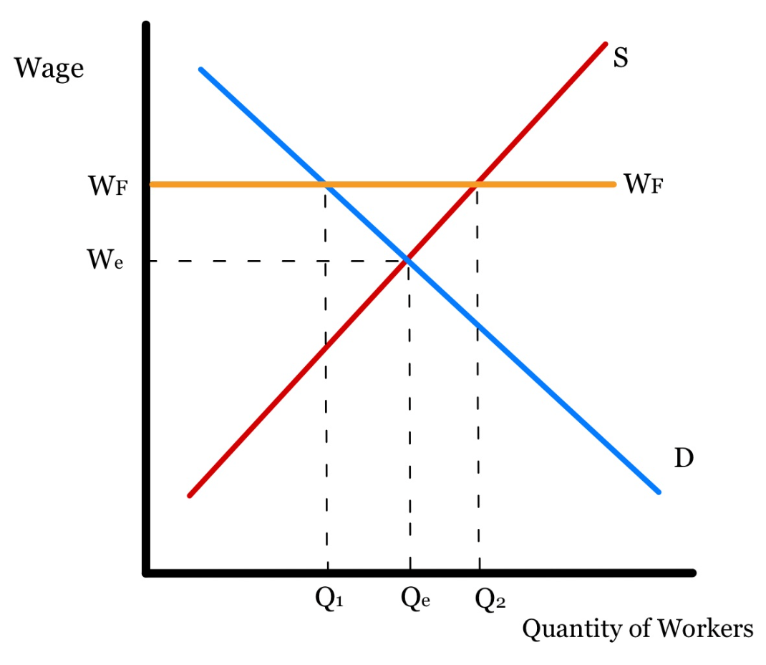
Effects of a Minimum Wage (Wage Floor)
Wage Floor
Copyright Bananaomics

Slide 19

Types of Unemployment - Course Hero

Slide 20


Case Study and TOK Connection
Article Button
Are robots taking over jobs? What is the impact on unemployment?
What skills will be required for future workers?
Will robots eventually be able to do everything human workers can?
Copyright Bananaomics

Slide 21

Definition
Natural Rate of Unemployment (Full Employment)
Percentage of people structurally, frictionally, and seasonally unemployed.
There will always be changes in skills desired by businesses, people switching careers, and seasonal jobs.
This is why no economy strives for no unemployment but rather a low rate (4-6 percent typically).
Copyright Bananaomics

Slide 22

Costs of Unemployment
Copyright Bananaomics

Slide 23

Costs of Unemployment
Economic Costs
Personal Costs
Social Costs
  Lost of GDP
  Loss of Tax Revenue
  Increased Unemployment Benefit Cost
  Lost of Income for Individuals
  Greater Income Inequality
  Increased Debt (e.g. Credit Card)
  Increased stress, anxiety, and depression
  Increased Crime Rate
  Loss of Access to Healthcare
Copyright Bananaomics

Slide 24

Solutions to Unemployment
Copyright Bananaomics

Slide 25
Brainstorm solutions to each type of unemployment.
Copyright Bananaomics

Slide 26
Solutions to Unemployment
How to fix . . .
Cyclical Unemployment
The economy needs to increase AD to combat the recession.
Structural Unemployment
The economy needs to implement policies aimed at increasing education and flexibility in the labor market.
General Unemployment
An effective welfare system allows those who are unemployed to stay out of poverty and find new employment.
Copyright Bananaomics

Slide 27

Practice Question
Copyright Bananaomics

Slide 28
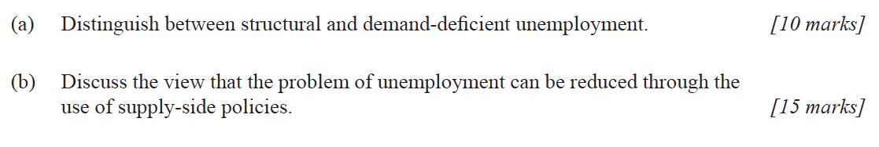
Paper 1
14N.1.HL.TZ0.3a
Copyright Bananaomics

Slide 29
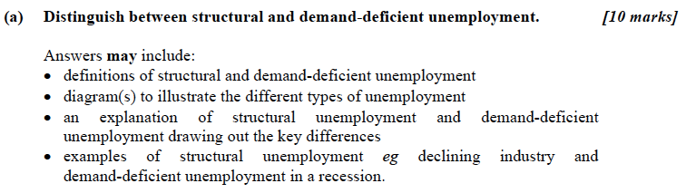
Mark Scheme
Copyright Bananaomics

Slide 30
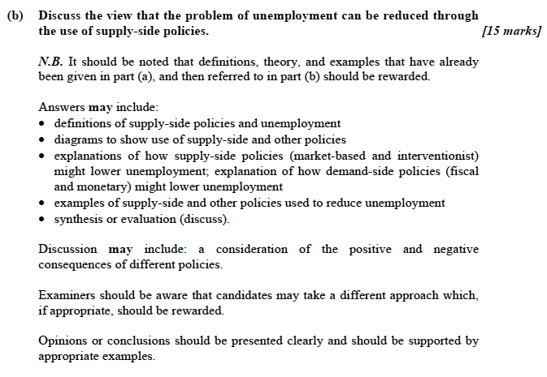
Mark Scheme
Copyright Bananaomics

Slide 31

Enjoying The Content?
Visit bananaomics.com to purchase package deals with discount prices!
BANANAOMICS

